Slide 1
Advanced Topics

Slide 2
Outline
Calculating Z-scores for pituitary R2 and volume
Using a 3T magnet
Calculator for LV function Z-scores
Role of T1 and T2 imaging in the heart

Slide 3
Exam for Pituitary Iron
3D T1 –weighted images (in any plane) with 1 mm isotropic resolution (3-6 minutes)
Multiple echo, spin-echo (CPMG) images with 8 echo times from 15 to 120 ms
Can perform a truncated exponential fit of the anterior pituitary (exclude the posterior pituitary from the ROI)
I traced the pituitary volumes for the anterior and pituitary volume separately on my Radiology PACS system and use a spreadsheet to calculate the volumes and Z-scores.

Slide 4
Pituitary Z-Calculator
File is called “PituitaryWorksheet”

Slide 5
Imaging at 3T
T2* decays twice as fast
T2/R2 imaging is almost useless because of B1 inhomogeneity
Cardiac imaging can be performed successfully at 3T without special sequences, however susceptibility artifacts are worse
Liver R2* using standard techniques is limited by initial echo time
First Echo Time | Maximum LIC 3.0T
0.6 | 32
0.7 | 27
0.8 | 24
0.9 | 21
1.0 | 19
1.1 | 17
1.2 | 16
1.3 | 14
1.4 | 13
1.5 | 12

Slide 6
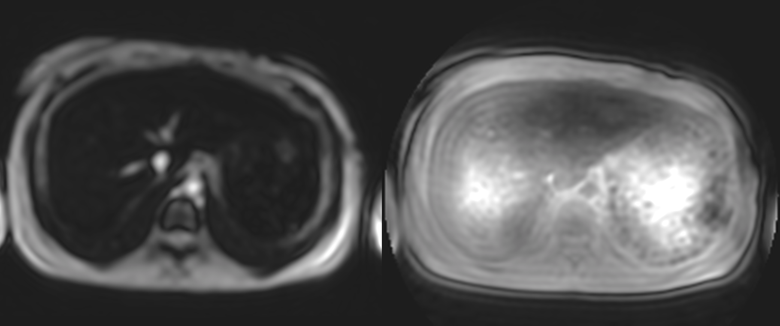
UTE for 3T LIC measurements
Gradient Echo, 0.7 ms
3D, T1-weighted FFE
Radial, density 160% sampling
UTE FID, no delay, full pulse
TFE factor 200
FOV 310 x 310 x 60
6 Slices, Thickness 15, skip 5
TR 4 ms, Flip 5-10 degrees
TE 0.19, 0.23, 0.35, 0.6, 0.85, 1.2, 2.0 ms
UTE Radial, 0.19 ms

Slide 7
UTE Results
Doyle et al, MRM In press
Notes:
The findings were highly correlated.
Previous research showed that R2* should approximately double with a doubling of field strength.
We found that UTE imaging was highly correlated over a wide range of liver iron values.
This demonstrates that UTE imaging has great promise as a scanning procedure at 3T and will increase the dynamic range of 1.5T scanning to 60 mg/g.

Slide 8
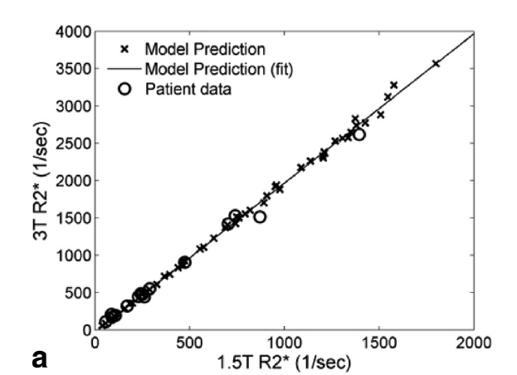
What about calibration?
Calibration of 3T R2* is well validated & follows contrast Eq.
R2*_{3T} – R2*_{3N}= (R2*_{1.5T}-R2*_{1.5N})*RE
R2*_{1.5T}=(R2*_{3T} – R2*_{3N})/RE+R2*_{1.5N}

Slide 9
Calculation from 3T data
File is called “3T_1.5T Converter”

Slide 10
Outline
Calculating Z-scores for pituitary R2 and volume
Using a 3T magnet
Calculator for LV function Z-scores
Role of T1 and T2 imaging in the heart

Slide 11
What function parameters to run
MRI is much more accurate than echo in detecting preclinical dysfunction from iron
With modern acceleration techniques, a complete short axis stack can be acquired in 4 breath holds or 3” free breathing
Tracing requires vendor software
I also acquire aortic and mitral flows for cardiac output and diastolic function

Slide 12
Ventricular Volume Z-scores

Slide 13
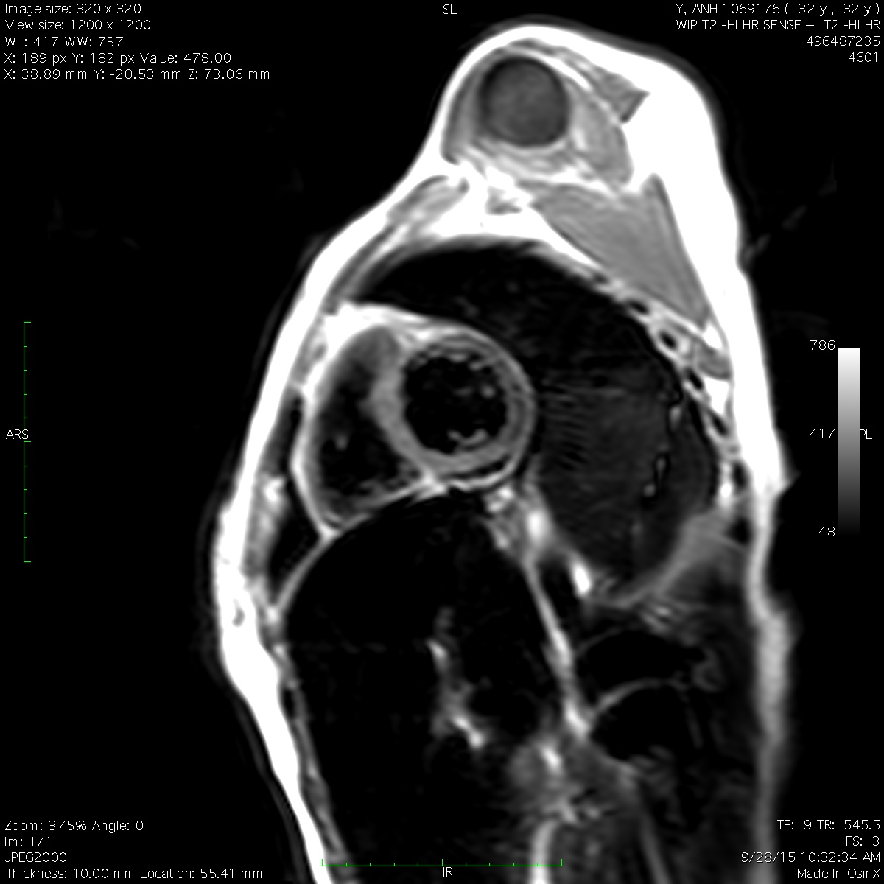
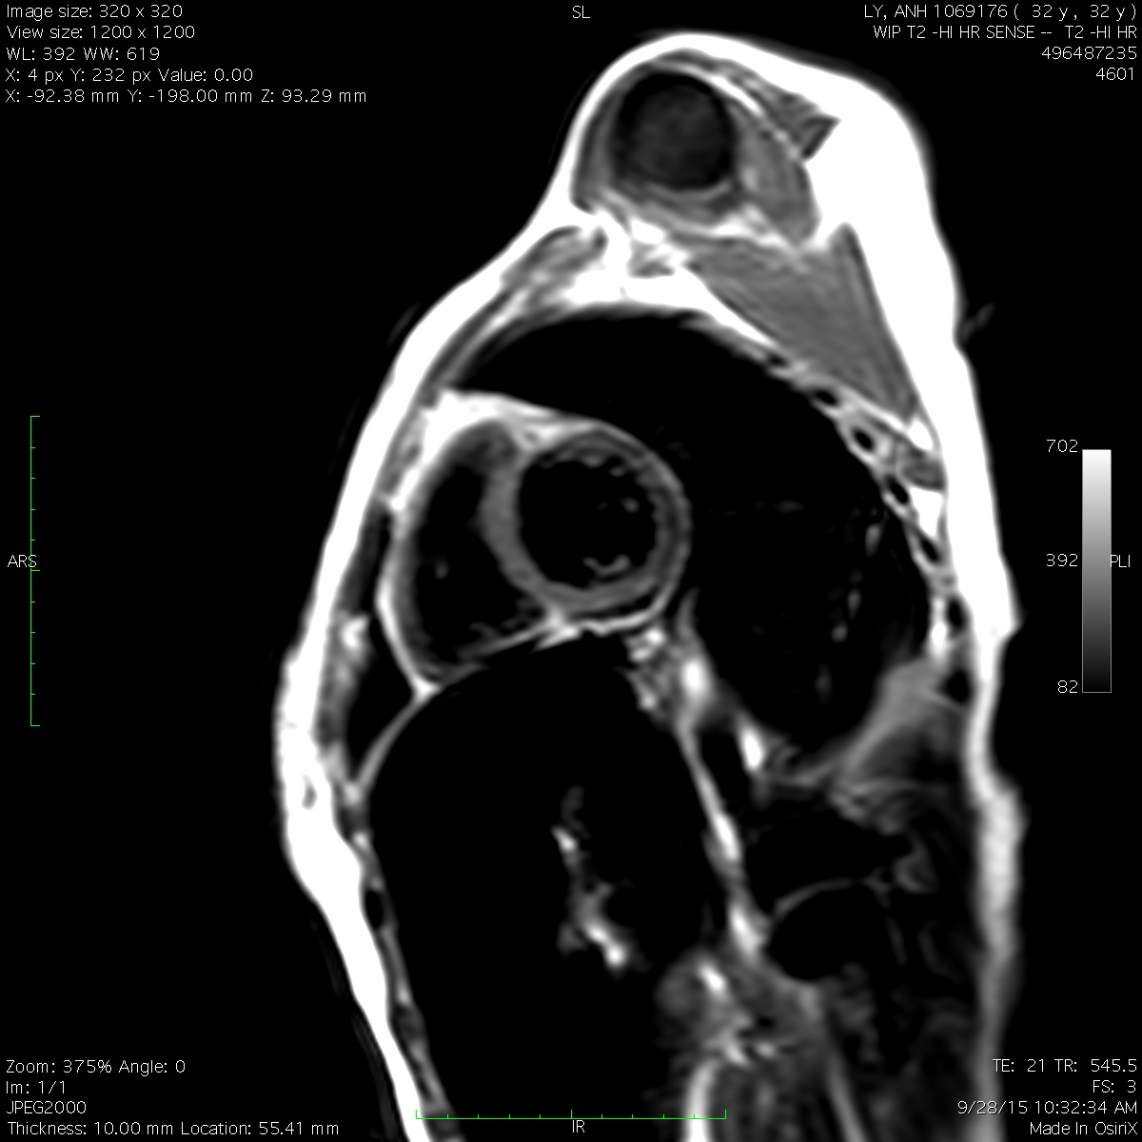
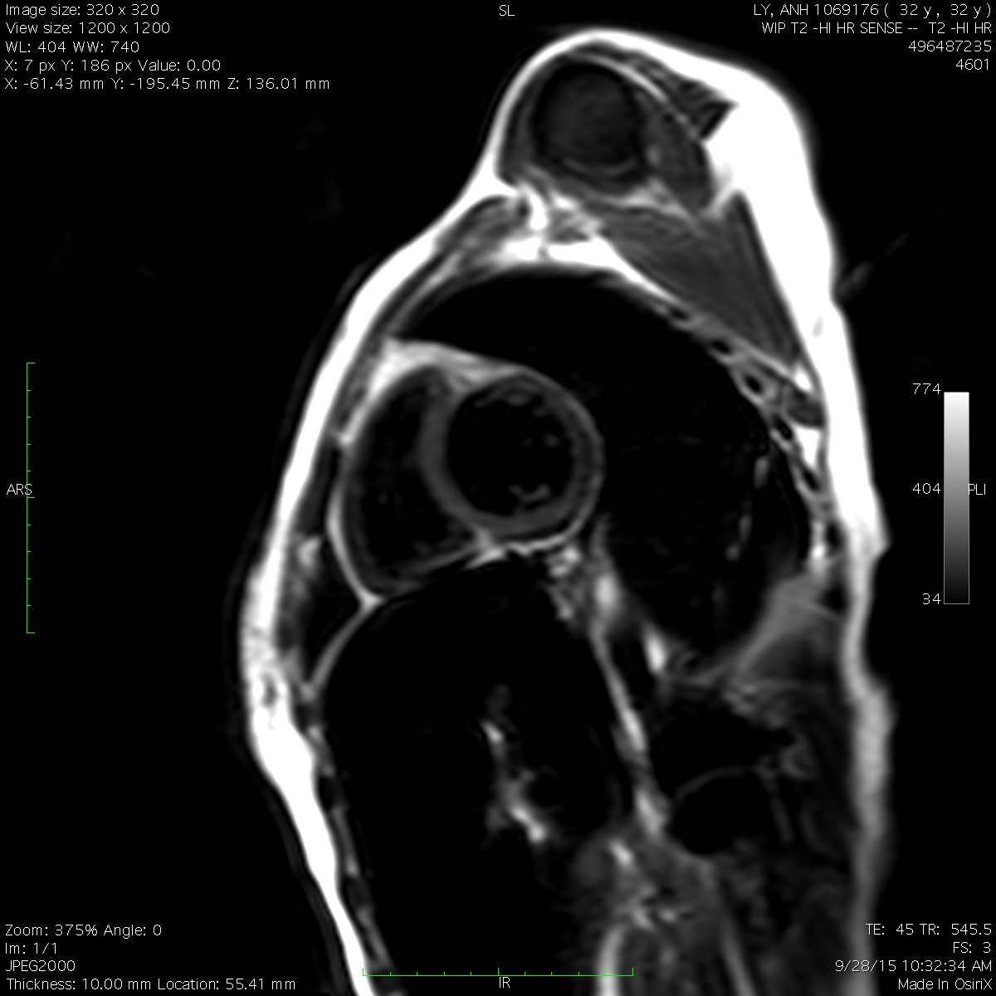
Cardiac T2
Similar principle to T2* but using a spin-echo instead of a gradient echo.
More robust to magnetic field inhomogeneities (like portacaths).
Has been validated against autopsy. Smaller dynamic range than R2*.
Is more sensitive to smaller iron deposits than R2*.

Slide 14
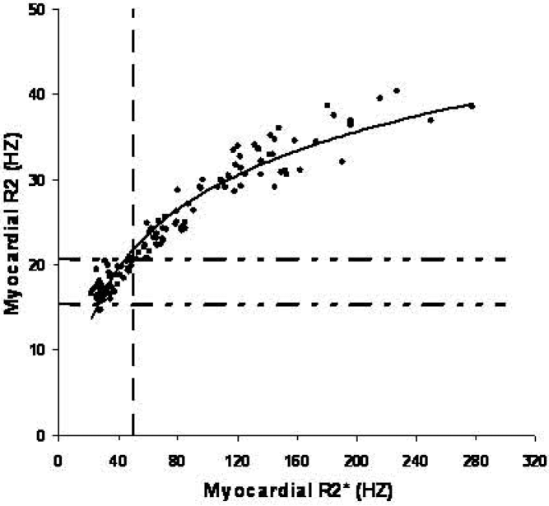
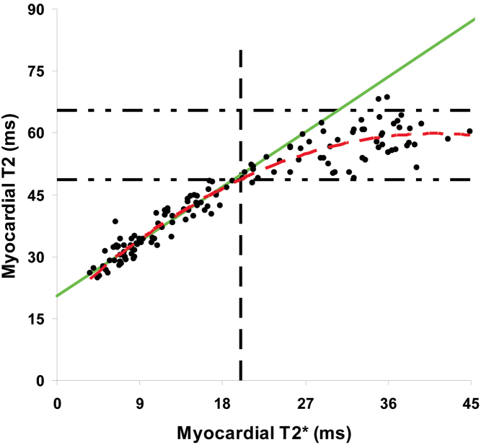
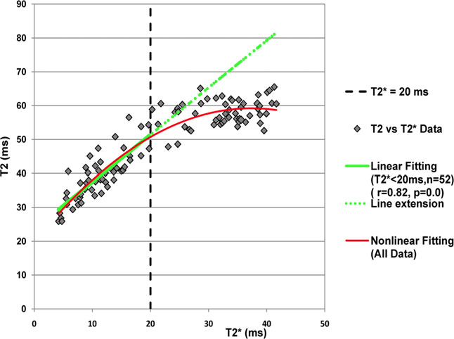
Comparing T2 and T2*
Liver
Ferritin
Hemosiderin
Heart
Liver
He T et al, MRM 61(3):501-6, 2009
Feng et al, JMRI, 38:588–593 (2013)

Slide 15
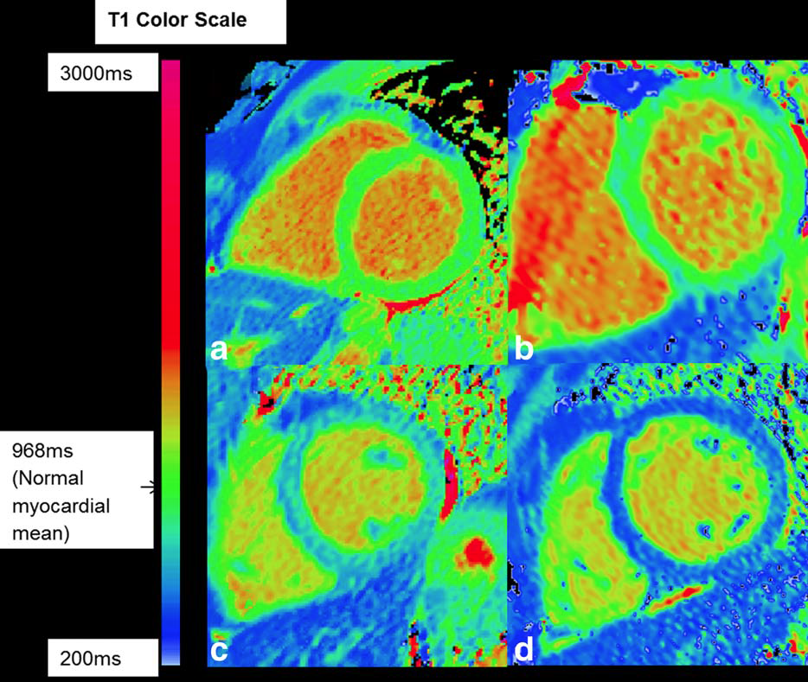
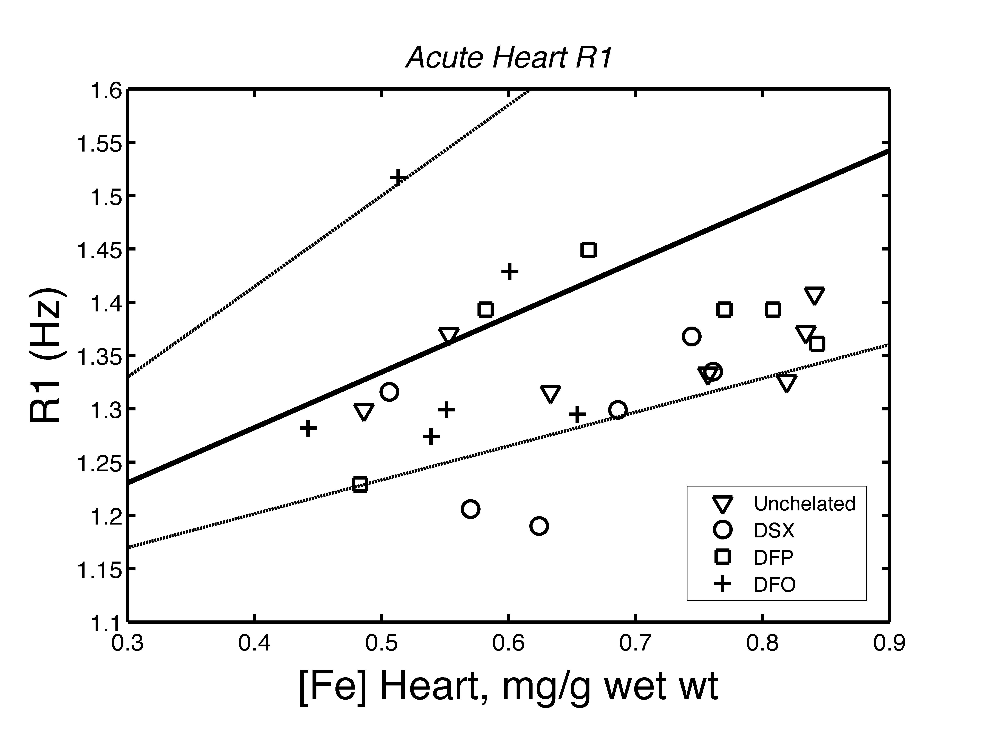
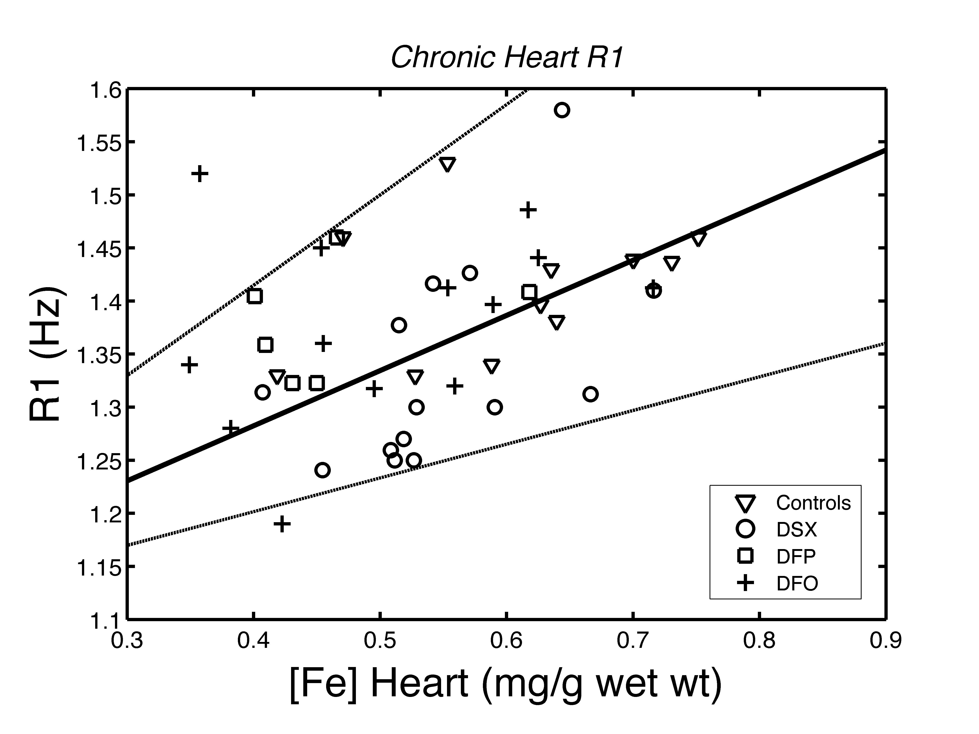
Cardiac T1 and heart iron
T1 is just another MRI relaxation parameter
It is sensitive to iron, although not as sensitive as T2 and T2*.
It used to be hard to measure in heart because of motion.
The change in cardiac T1 can also be used to measure fibrosis.
Sado et al, JMRI 41:1505–1511 (2015)
Doubling iron-> ⬇12%T1 COV is ~3-4%.
Wood et al, MRM 60(1):82-89,2008

Slide 16
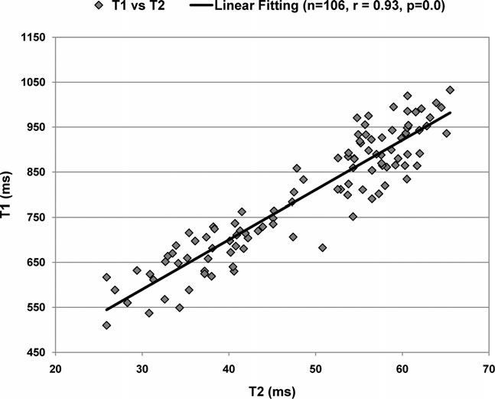
T1 is proportional to T2
T1 and T2 vary linearly with one another.
Relationship trends even with T2* in normal range.
Some argue the T1 and T2 are more reproducible than T2*.
However, validation are lacking.
T2* 20 ms
Feng Y et al, JMRI 38(3):588-93, 2013

Slide 17
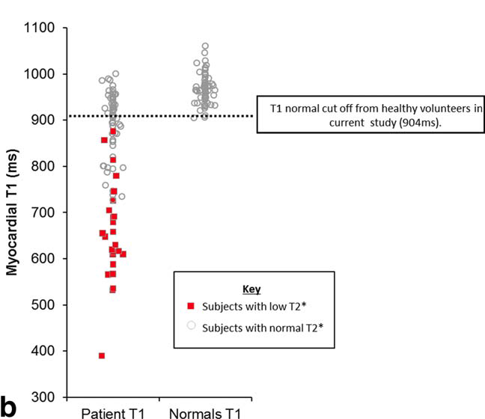
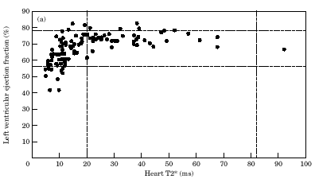

Early warning system ?
Low T1 may indicate early cardiac iron loading.
Sado et al, JMRI 41:1505–1511 (2015)

Slide 18
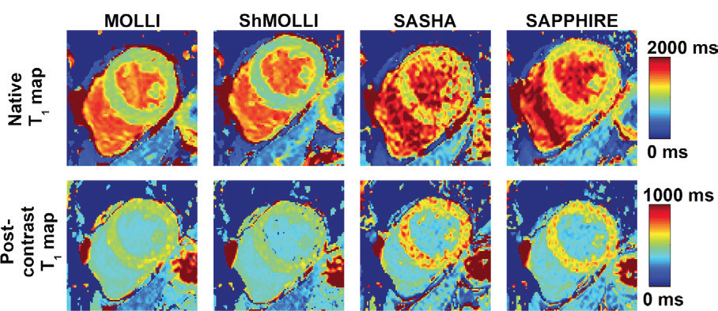
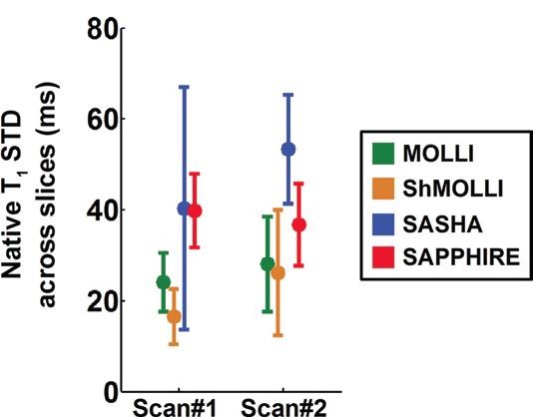
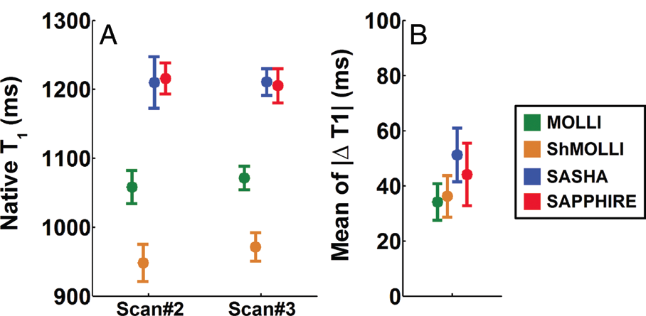
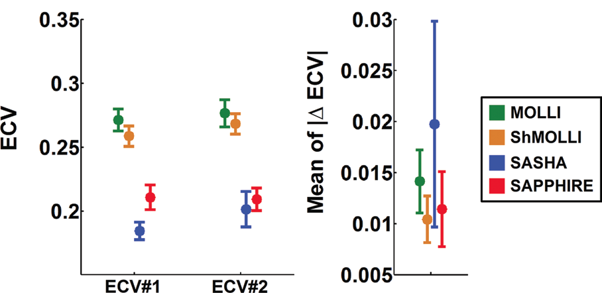
Comparison of T1 methods
Slice to slice reproducibilty
Interstudy reproducibilty

Slide 19
T1 mapping ?
Advantages
Disadvantages
Some scanners output a T1 map automatically.
May be more sensitive to low iron.
Can be used, with contrast, to assess fibrosis.
Numbers vary with technique.
Interscanner reproducibility has not been proven.
Motion artifacts with high heart rate.
T1 changes are not specific.
Not clinically validated.

Slide 20
Calculation of ECV
Extracellular volume (ECV) is the percent of water between cells and is a marker of fibrosis.
Enter the patient hematocrit and measured T1 values.
File is called “ECV Calculator”

Slide 21
Do we really need T1, T2, to track iron ?
Trends in T2* are highly robust.
Pancreas T2* also offers insights into response.

Slide 22
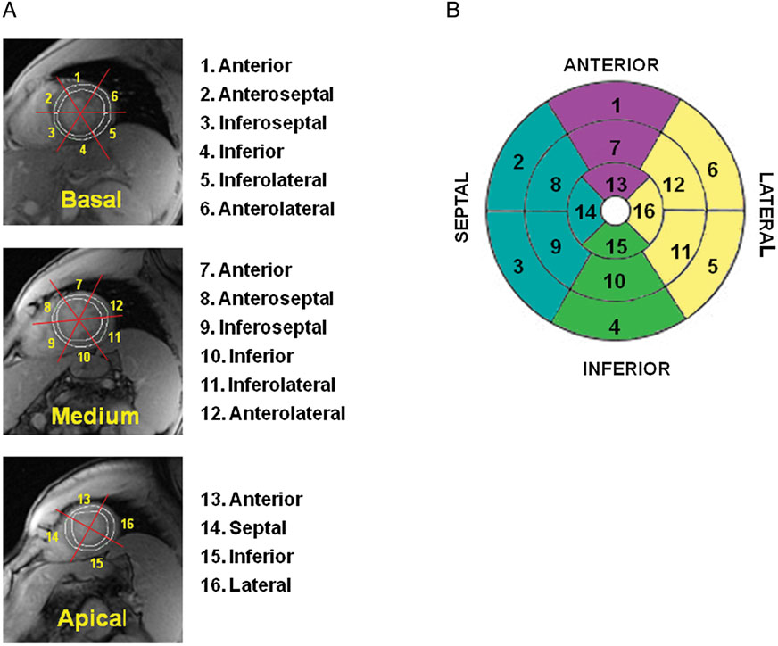
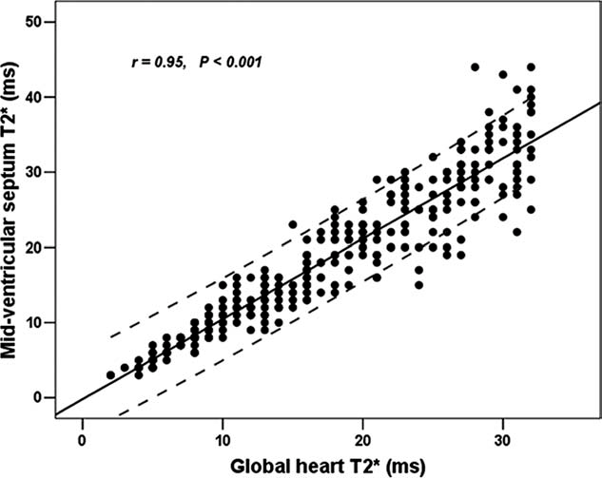
Multislice, multiple ROI approach
All segments normal
Some segments abnormal, T2* > 20
Some segments abnormal, T2* < 20
All segments abnormal
Pepe et al, JMRI 23:662-8, 2006
Meloni et al, JMRI 64:211-219, 2010
Eur Heart J, Cardiovasc Imaging 16, 325–334, 2015

Slide 23
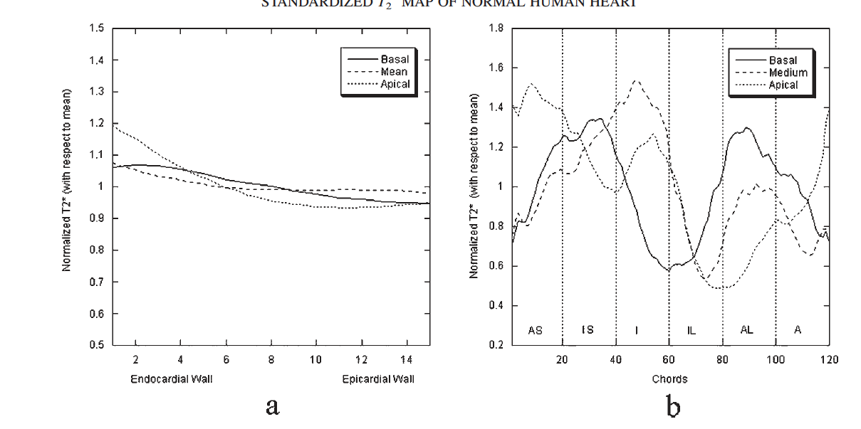
Correcting for susceptibility variations
Positiano et al, NMR in Biomedicine, 20:578-590, 2007
Positiano et al, NMR in Biomedicine, 22:707-715, 2009
Background correction has not been validated in an independent non-iron loaded cohort.
Susceptibility effects are not linear.

Slide 24
Summary for Cardiac Iron
T1, T2, and T2* all reflect cardiac iron.
T2* is robust across imaging platforms and is well calibrated to cardiac risk;
Black blood is a good idea but not a game changer.
Cardiac T2* at 3T is feasible and calibrated.
T2* between 20-25 is abnormal and 25-30 ms is borderline.
Multi-slice, multi-segment T2* assessment does not offer clinical advantages to good septal T2* assessment.
T2 and T1 could potentially help identify early cardiac iron deposition.
T1 mapping assessment of ECV is potentially a powerful tool to probe the prevalence and etiology of fibrosis in iron overload disorders.

Slide 25

Questions?

